Slide 1
Types of Information Systems
What will be covered:
Example of Information System
Categories/Classification of information Systems
The main types of information systems.

Slide 2
Introduction
Management at different level take decisions matching to their hierarchy position in the organization and different types of information system are designed and developed for them. The lowest level is managed by operational level mangers. The routine office work are mostly done at this level. No decision making process is carried out here but proper organization and processing of data is important task. So, data processing systems like TPS are developed for them.

Slide 3
Introduction cont’d
The middle levels management is responsible for routine decision making. In order to help them, information system like MIS is designed for them. It collects data from internal and external sources and provides information to management.
The top level management is responsible for non-routine, strategic decision making. In order to help them information system like DSS is designed for them. It helps them by providing information and decision model.

Slide 4
Information System Example
An information system is a software system to capture, transmit, store, retrieve, manipulate, or display information, thereby supporting people, organizations, or other software systems.
Example: In the example of the family doctor, the Information System is the software system that stores the data of the patient. This information system supports a person: the doctor.

Slide 5
Primarily, information system can be classified into three broad categories
Information Systems
Operation
Support System
Management
Support System
Office Automation
System (OAS)
TPS
MIS
ERP
DSS
EIS
ES
Word Processing
System
Document
Management
System
Message
Communication
System
Tele-
Conferencing
System

Slide 6
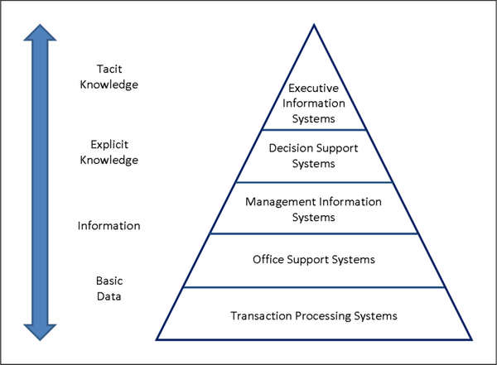
Types OF info Systems
KBS:Knowledge Management Systems or expert systems
ESS: Executive Support Systems
DSS: Decision Support Systems
MIS : Managament Information Systems
OAS: Office Automation Systems
TPS Transaction Processing Systems

Slide 7
classifications of information systems
Operations Support System (OSS) is aimed to improve operational efficiency of the enterprise. It is further classified into three categories : TPS, MIS and ERP.
Management support system(MSS) is an information system that integrates the functional capabilities of a decision support system, executive information system, and knowledge-based or expert system
An office automation system Involves software and computer systems to collect, store, modify, transmit, and use shared information to automate manual tasks. It's an efficient way to manage and share data.

Slide 8
Operations Support System (OSS) Transaction Processing Systems (TPS)
TPS is A computerized system that performs and records daily routine transactions necessary to conduct the business.
TPS is a type of Information system that collect, store, modify and retrieve the transactions of an organization.
A Transaction is an event that generates or modifies data that is eventually stored in an information system
Usually operated directly by shop workers or front line staff, which provide the key data required to support the management of operations. This data is usually obtained through the automated or semi-automated tracking of low-level activities and basic transactions.

Slide 9
Examples of Transaction Processing Systems
Payroll system
Reservations systems
Order processing systems
Systems for payments and funds transfers
Billing systems to send invoices to customers
Systems to calculate the weekly and monthly tax payments
These systems help any company to conduct operations and keep track of its activities

Slide 10
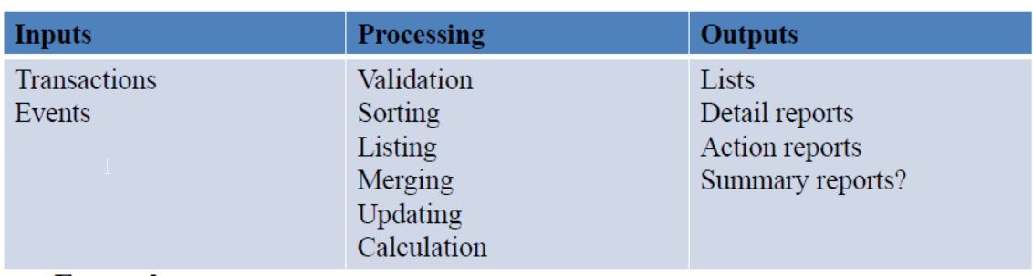
Five Stages Of Transaction Processing System
Data Entry
Processing
Database Maintenance
Document and Report Generation
Inquiry Processing
Functions of a TPS

Slide 11
Types of Transaction Processing systems
i)Batch Processing
Batch processing requires separate programs for input, process and output. Batch processing is a resource-saving transaction type that stores data for processing at pre-defined times. It is useful for enterprises that need to process large amounts of data using limited resources
Example
Credit card’s monthly statement for the customer.
Library books overdue reminders, Journals missing issues reminders.
NEFT transfer (National Electronic Funds Transfer).
ii) Real-Time Processing
Involves a constant input, process and output of data.
Data must be processed in a small time period (or near real time).
Example
A bank customer withdraws a sum of money from his or her account. The account balance updated as soon as possible.
Airline ticket booking.
IMPS (Immediate Payment Service)

Slide 12
Features/Characteristics Of Transaction Processing Systems
Rapid Processing
The rapid processing of transactions is vital to the success of any enterprise.
TPS systems are designed to process transactions instantly.
Reliability
TPS systems are designed to incorporate comprehensive measures to safeguards and disaster recovery.
These measures keep the failure rate well within tolerance levels.
Standardization
Transactions must be processed in the same way each time to maximize efficiency.
TPS interfaces are designed to acquire identical data for each transaction, regardless of the customer.
Controlled Access
Access must be restricted to authorized employees to use.
Employees who lack the skills and ability to control, cannot do the transaction process.

Slide 13
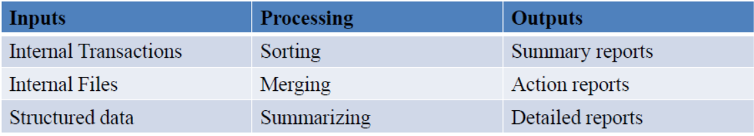
Operations Support System (OSS)
Management Information Systems (MIS)
Management Information Systems are management-level systems that are used by middle managers to help ensure the smooth running of the organization in the short to medium term.
A management information system is an information system used for decision-making, and for the coordination, control, analysis, and visualization of information in an organization.
The highly structured information provided by these systems allows managers to evaluate an organization's performance by comparing current with previous outputs.
MIS primarily serve the functions of planning, controlling, and decision making at the management level.
Functions of MIS

Slide 14
Examples of MIS
Sales management systems
Inventory control systems
Budgeting systems
Management Reporting Systems (MRS)
MIS REPORTS
Several types of reports can be produced
Summary reports present all activity over a given time period, geographic region, or other categorization in aggregate form.
Exception reports only present information that is out of normal ranges.
On-demand reports present anticipated summaries only when a manager wants or needs to check the status of activities.

Slide 15
Applications of MIS
Strategic Support
Computers cannot create business strategies by themselves but assist management and help in taking effective decision-making.
MIS systems can be used to transform data into information that is useful for decision making.
Data Processing
MIS systems provide a valuable time saving benefit to the workforce.
They allow for faster decision making and quicker reactions for the enterprise as a whole.

Slide 16
Operations Support System (OSS)
ERP : Enterprise Resource Planning
"An ERP is a fully integrated business management system that integrates the core business and management processes to provide an organization a structured environment in which decisions are supported by accurate and reliable real-time information.“
Objectives
Provide support for adopting best business practices
Implement these practices with the view towards enhancing productivity
Empower the customers and suppliers to modify the implemented business processes to suit their need.

Slide 17
ERP Supported Business Processes
Business system: Business planning and forecasting, Strategy formulation, Resources allocation, Monitoring & controlling company performance etc. are some of the activities of this process which are supported by ERP.
Production: Production planning and control, Production scheduling, Inventory management, are also some of the activities which are supported by ERP.
Maintenance: Plant maintenance-Breakdown & Preventive measures; Maintenance management-initiation, execution, control, and costing; Monitoring the performance of maintenance program and MIS are the activities supported by ERP.

Slide 18
ERP Supported Business Processes cont’d
Quality Control: Setting quality standards, quality assessment, analysis of quality, and building quality assurance are some of the activities which are supported by ERP.
Marketing: Marketing analysis by customer; Product and Sales forecasting; Sales budgeting; Order processing and analysis, are also activities supported by ERP.

Slide 19
Finance: Financial Accounting; Asset management; Cash/Debt management; Accounts payable and receivable; Tax management; Cost/Profit center accounting etc are the activities which are supported by ERP.
Personnel: HR planning, Recruitment and Selection; Training; Performance appraisal; Compensation; Employee welfare are the activities supported by ERP.
Consolidation of business operations: Consolidation of accounts maintained by units and divisions; and Comprehensive reporting are some of the activities supported by ERP.

Slide 20
Characteristics/Features Of ERP:
A system has to posses few key characteristics to qualify for a true ERP system. These features are –
Flexibility ERP should be flexible to respond to the changing needs of enterprises technology (to run ERP)
Every user or operating client computer, can obtain any information according to their individual requirement.
Integrated & Open
ERP must be based on Open System Architecture that allow any module to attach and detach whenever required without affecting other module. ERP must support multiple hardware platforms and third party add-Ins.

Slide 21
Comprehensive ERP should support variety of organizational functions and wide variety of organizations
Beyond the company: ERP should not be confined to the organizational boundaries rather support inter - organizational activities also.
Best business proactive
ERP must have a collection of best business processes applicable worldwide, combined with company's policy, strategy and culture.

Slide 22
Benefits Of ERP
i. Better utilization of organizational resources
ii. Lowering operating cost
iii. Proactive Decision Making
iv. Decentralized decision making
v. Enhanced customer satisfaction
vi. Flexibility in business operations

Slide 23
Management Support System
Decision support systems (DSS)
DSS is a system that allows senior managers to take non-routine decisions. This kind of system allows solving problems that are unique and frequently change. DSS uses mathematical models and statistical techniques to support decision making. Some common statistical techniques are predictive modeling and probability.
Are also computer-based information system that supports business or organizational decision making activities, typically resulting in ranking, sorting or choosing from among alternatives. DSS are interactive and are used to solve ill structured problems. They offer access to databases, analytical tools, allow "what if" simulations, and support the exchange of information within the organization.

Slide 24
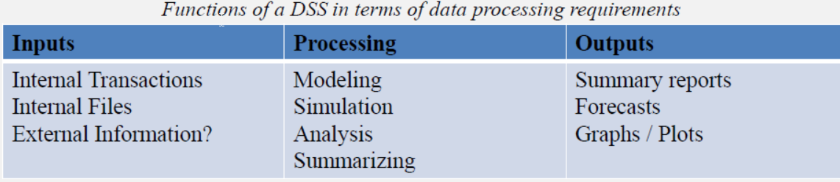
Functions of DSS
DSS manipulate and build upon the information from a MIS and TPS to generate insights and new information
Examples of DSS
• Group Decision Support Systems (GDSS)
• Computer Supported Co-operative work (CSCW)
• Logistics systems
• Financial Planning systems

Slide 25
Components of DSS
Database: Stores large amounts of data relevant to problems the DSS has been designed to tackle.
Model base: Contains one or more models that can be used to analyze the decision situation
Dialogue module: Provides a way for the decision maker, usually a non-technical manager, to communicate with the DSS.

Slide 26
Management Support System
Executive Support Systems
An Executive Support System (ESS) also known as Executive Information System is software that allows users to transform enterprise data into quickly accessible and executive-level reports, such as those used by billing, accounting and staffing departments. An ESS enhances decision making for executives.
EIS is an information system based on computer which generally serves the information needs of the top level management(executive managers) of an organization
Information is usually external, unstructured and uncertain. Furthermore, this information is intelligence-based. Some examples of intelligent information are databases, patent records, financial reports, market reports, technical reports from consultants, government policies and confidential information about competitors.

Slide 27
An ESS provides potential outcomes and quick statistical data that are applied to decision making processes
Users can extract much needed information without the hardship to learn complex query language.
It enables the users to get information on time without any delay. It enables users to have access to management reports.

Slide 28
EIS system is very fast. It is capable of accessing both internal as well as external data.
EIS basically provides various online options with which the report analysis can be done in detail.
EIS provides its users with drill down facility and reporting tools.
EIS can also be used to make decision just like Decision Support System.
EIS helps management to monitor performance of the organization and thus helps organization to achieve its goals and objectives in the long run

Slide 29
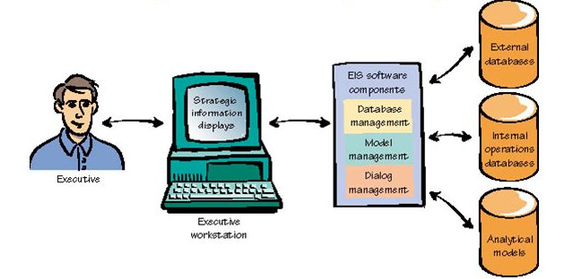
Components of ESS(EIS)
Discuss the components of an ESS

Slide 30
Characteristics Of EIS
"An EIS is a tool that provides direct on-line access to relevant information in a useful & controllable Format. It has the following characteristics -
Specifically designed to meet executive's information need.
Able to access data about specific issues and problems.
Provide on -line analysis tool
Can access both internal and external data
Easy to use i.e. GUI based software, user friendly hardware like mouse, touch screen etc.
Used directly by executive without technical assistance
Present information by graphical means
Present summary information instead of details
Able to manipulate data to perform “what –if” analysis

Slide 31
Contents of EIS
In the broadest sense the contents of EIS are "whatever is interesting to executive". EIS implementations begins with just a few contents that are of interest to executives and then expand in response to managers need as they use the system. Following is a set of principles to guide the design of contents to be included in EIS -
EIS contents must be easy to understand and collect. It should not add to the work load of mgrs.
EIS content should reflect the objectives of the organization in the area of productivity, resource management, quality and customer service.
Performance indicator in EIS must reflect everyone's contribution.
Performance indicator must promote both team-work and friendly competition.
EIS content must be available to everyone in the organization
EIS content must be open to meet the changing need of the organization

Slide 32
Management Support System
Expert systems (ES)
Expert systems are the software that imitate the reasoning processes of human experts and provide decision makers with the type of advice they would normally receive from such experts.
Support professionals faced with complex situations requiring expert knowledge in a well-defined area. Expert systems are based on principles of artificial intelligence research. These systems use human knowledge captured in a computer to solve problems that ordinarily need human expertise.

Slide 33
Imitating human expertise and intelligence requires that the computer
recognize, formulate and solve a problem;
explain solutions
And learn from experience.
These systems explain the logic of their advice to the user; hence, in addition to solving problems they can also serve as a teacher.
They use flexible thinking processes and can accommodate new knowledge.

Slide 34
Application of Expert systems
Some of the business applications of expert system are
Accounting and Finance: Tax advice and assistance, Forecasting, Providing investment advice etc.
Marketing: Sales proportions, Handling customers inquiries, Discount policies, Telemarketing etc.
Manufacturing: Process controlling, Quality controlling, Production scheduling, Selecting transporting route, Fault monitoring etc.
Personnel: Recruitment, Training, Task assignment, Performance appraisal
General business: Evaluating project proposal, Strategy selection, Reporting etc.

Slide 35
Properties of Expert systems
Availability: ES is always available to solve a problem which experts need to discuss.
Complexity: Problems for which ES will be used to solve, are complex tasks which would not be easily handled by unoriginal information processing.
Domain : The subject area of the problem is relatively small in ES.
Expertise: ES aim to solve the problem that require the efforts of experts.
Structure: ES handle problems with un-structured, un-certain and conflicting data.

Slide 36
Components Of Expert systems
An expert system is typically composed of the Knowledge base, Inference engine, Knowledge acquisition facility and User interface.
(a) Knowledge Base:
The knowledge base stores the data of problem, their solutions and the relationship between them. It formally represents the knowledge acquired from the expert so that solution for the problem can be done easily. The power of a system tends to be related to the depth of the knowledge in the knowledge base.

Slide 37
Inference Engine :
The inference engine is the main processing element consisting of system of programs that receives data from user, manipulate the knowledge base and provide a decision to the user. To identify solution of the problem, it employees different reasoning models such as –
Forward-Chaining mechanism : First examine the problem at hand and the knowledge base ; then it attempts to discover a solution.
Backward-Chaining mechanism : The Inference Engine starts a series of questions and tries to identify the user problem. Once the problem is diagnosed the solution is extracted from the knowledge base and recommended to the user.

Slide 38
(c) Knowledge Acquisition Subsystem (KAS) :
The Knowledge Acquisition Subsystem is the software component of the ES that enables the knowledge engineer to build and refine the ES's Knowledge base.
Knowledge base development and maintenance can be done using special, reasonable user-friendly software. This software provides a convenient and efficient means of capturing and storing the contents of the knowledge base.
(d) User Interface:
It is a program with which Expert system and User interacts with each other. The UI of ES prompts the user to supply information about the problem and the user types in the requested data. The system continue to prompt user for more information until the system has enough data about the current problem so that it can reach a conclusion. Thus the UI is a highly interactive component of ES.

Slide 39
Office Automation Systems (OAS)
Office automation is the process of watching data flow around on its own without any human intervention, inaccuracies, and errors. It is the process of using an automation tool to create, collect, store, analyze, and share confidential office data that is required to accomplish day-to-day routine tasks and processes effectively.
An office automation system is the tool that enables data to move from one system to another on its own without human intervention and inaccuracies. These tools help organizations collect, manage, and analyze securely to accomplish everyday tasks and processes. It optimizes and automates existing business processes and procedures

Slide 40
Office automation systems refers to the computer machinery and software used to digitally automate routine office tasks, such as creation of documents and billing
Or
Office automation systems are computer based information systems that collect, process, store and transmit electronic messages, documents and other forms of communications among individuals, work groups and organizations. Such systems can increase the productivity of managerial end users, other professional and staff personnel by significantly reducing the time and effort needed to produce, access and receive business communications.

Slide 41
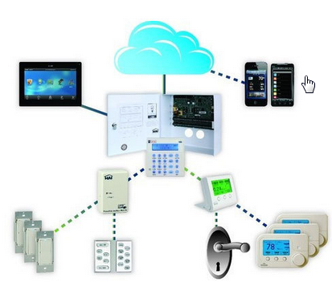
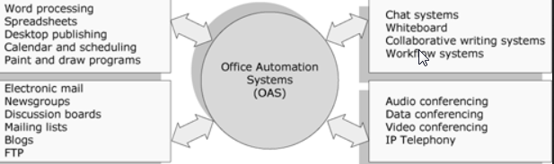
Components of Office automation systems

Slide 42
Main Types of Tools used by OAS Include:
MS Word, MS excel etc.
Text & image processing systems
Personal database systems and note-taking systems
OAS includes the following roles/activities:
Exchange of information
Management of administrative documents
Handling of numerical data
Meeting planning and management of work schedules

Slide 43
Different office activities supported by OAS
Document capture: This consists of capturing incoming documents such as mails, notes, handouts and graphs etc.
Document creation: This consists of preparation of documents, such as editing texts etc.
Receipts and Distribution : This includes distribution of correspondence to designated recipients.
Filling, Search, Retrieval and Follow up: This includes document filling, indexing and searching.
Calculation: This includes routine arithmetic calculation for bill processing, interest calculation, commission calculation etc.
Recording usage of resources: This includes Record keeping, Log book maintenance etc.

Slide 44
Word processing System:
May be simple word processor or Desktop publishing systems, supported by laser printer, Ink-jet printer and scanner these are the software used to produce good quality documents.
Since large proportion of the office communication takes place in writing, this is the most' commonly used component of OAS. These systems automate the process of development of documents such as letters, memos and reports etc.

Slide 45
Electronic Document Management Systems :
The computer based document management system are used to capturing the information contained in electronic document form, store for future reference and communicate the relevant parts to the users when required.
These systems are very useful in remote access of document that is almost impossible with manual document management systems. e.g.
A sales executive may submit customer order to the sales order processing system remotely,
The loan application files in a branch office of a bank can be accessed by the sanctioning officer for scrutiny at the head office.
With computer based document management system location of the user becomes irrelevant for access to the document.

Slide 46
Electronic message communication systems
Business organizations have been using a variety of communication systems for sending and receiving messages.
The computer based message communication systems offer a lot of economy not only in terms of reduced time but also in terms of reliability and cost of communication. Some of the EMCS are :
E-Mail: Transfer of message in electronic form. Some of its best features are -
Fast electronic transmission
Online composing and editing
Broadcasting and forwarding
Integration with other information systems
Portability
And being economical

Slide 47
Electronic message communication systems
Fax
Fax is electronic communication of image documents over telephone lines. The computer based fax technology permits sharing of fax facilities.
It uses special software and fax server to send and receive fax messages using common communication resources.
Voice mail
Voice mail allows transfer of messages in the form of digitized voice. The recipient of the voice mail can hear the spoken message in the voice of the sender.

Slide 48
Tele-conferencing or Video-conferencing systems
Conference is a business meeting involving two or more persons located at different places. Teleconferencing helps in reducing time and cost of meeting as the participants do not have to travel to attend the meeting. It may be audio or video conferencing with or without computer systems. These systems are based on PCs with digital camera and multimedia soft wares

